Slide 1
Mountainboard - Lesson 1
Using the Interface
School’s Name
Teacher’s Name
Date

Slide 2
Using the Interface
The interface is how you interact with the computer in the following ways:
Use windows to view files.
Use the mouse to select buttons, menus, and model elements.
Run programs — like SolidWorks mechanical design software.
Find, open, and work with files.
Create, save, and copy files.

Slide 3
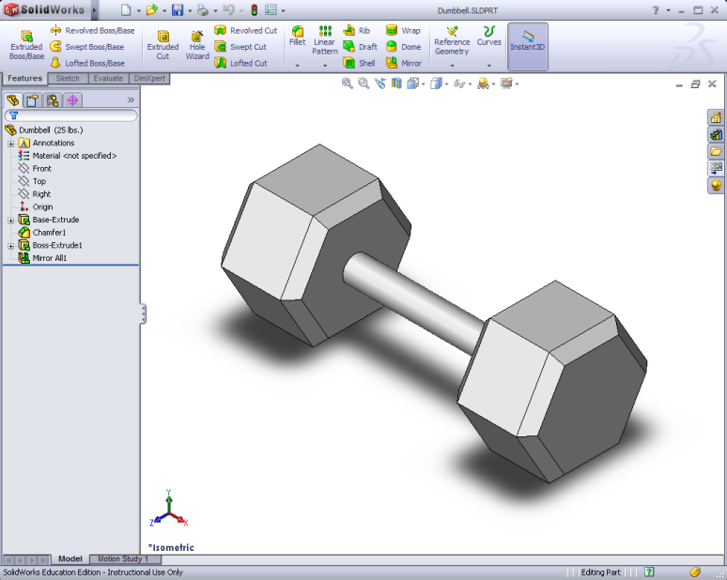
Microsoft® Windows®
SolidWorks runs on
the Microsoft
Windows graphical
user interface.
Windows let you see
the work of an
application program.
Panels are sub sections of windows.
Illustration shows one window with two panels.

Slide 4

Using the Mouse
The mouse lets you move around the interface.
The cursor is the pointer that shows you where the mouse is on the screen.
Click the left mouse button to select commands, buttons, geometry, and other elements.
Double-click the left mouse button to quickly open a file or folder.
Click the right mouse button to access a shortcut menu of frequently used commands.

Slide 5

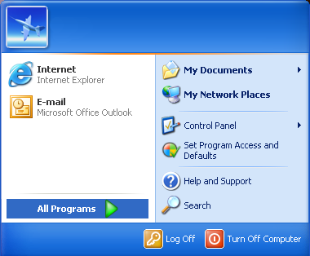

Running Programs
The quickest way to start a program is to double-click on a desktop shortcut.
Some programs may not have desktop shortcuts.
The Programs menu lists all of the application
programs resident on the computer.

Slide 6
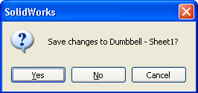
Exit a Program
Select or click File, Exit to end a program.
If the file has unsaved changes, you have the chance to save the them before exiting.

Slide 7
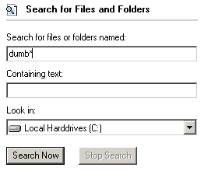
Searching for a File or Folder
Click , Search, All files and folders to find files or folders.
Enter the search criteria in
All or part of the file name:
If the search continues after
you have found the file or
folder, click .
Use * to perform wild card
searches.

Slide 8
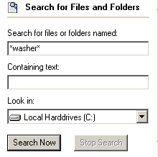
Wild Card Searches
Search for all files of a particular type by searching for the file type suffix.
  Example: *.SLDPRT
Search for all files that begin the same.
  Example: bearing*
Search for all files that have
common letters in the file name.
  Example *plate*

Slide 9
Opening a File
The quickest way to open a file is to double-click on it.
The File menu displays your most recently used files.

Slide 10
Saving and Copying Files
Saving a file preserves the changes
that you have made to it.
Use File, Save As to copy a file.
File, Save As creates an exact duplicate of the file as it existed at the moment that you copied it.

Slide 11



Resizing Windows
Allows you to customize the appearance of your screen.
View multiple files at the same time.
Use to change the size of a window.
Use to change the size of panels within a window.

Slide 12

Using the SolidWorks Interface
SolidWorks windows display graphic and non-graphic model data.
Toolbars display frequently used commands.

Slide 13
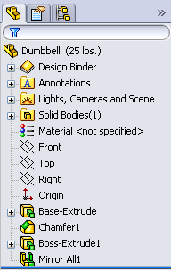
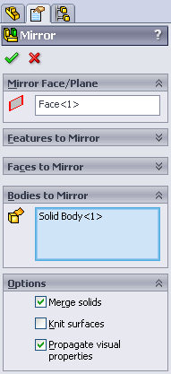

Left Side of SolidWorks Window
FeatureManager design tree™
Property Manager
Configuration Manager

Slide 14
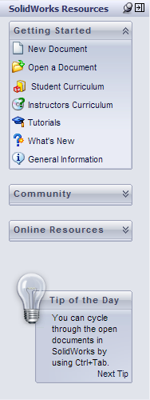
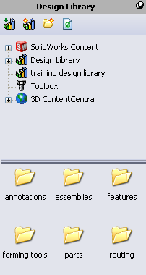
Right Side of SolidWorks Window
The Task Pane
SolidWorks Resources
Design Library

Slide 15
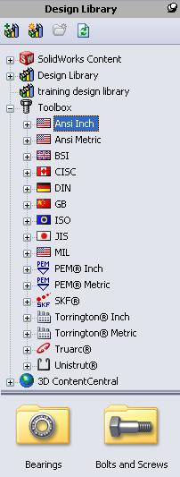

Right Side of SolidWorks Window
The Task Pane
Toolbox
File Explorer

Slide 16
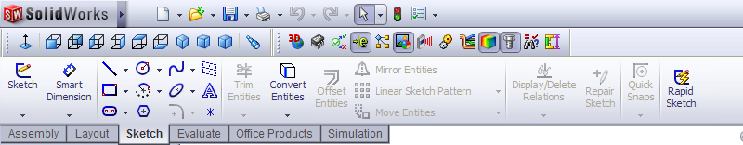
Toolbars
Buttons for frequently used commands.
You can select the toolbars to display.
Toolbars are displayed at the top and sides of the window.
You can also access the toolbars from the CommandManager.

Slide 17
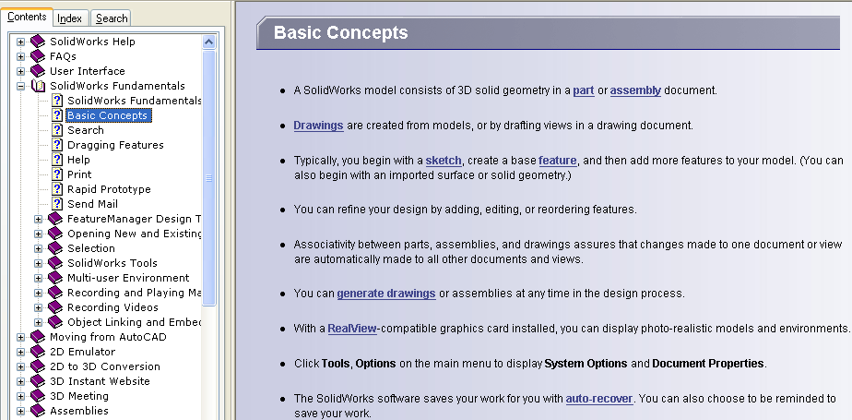
Getting Help
To view comprehensive online help:
Click .
Select Help,
SolidWorks Help.
Help displays in a
separate window.

